Slide 1


CONSUMER GOODS AD-hoc insight

Slide 2

Situation
The management identified the need for actionable insights and data-driven decisions and plans to evaluate applicants using a SQL challenge.
Task
Ad-hoc Request
Action
Understanding 10 Ad-hoc request
Result
presentation demonstrated technical expertise and business acumen
Write and executing SQL query
Management friendly dashboard
Presentation
Using Joins, Group, Having, Order By, Ranking, Window Function

Slide 3
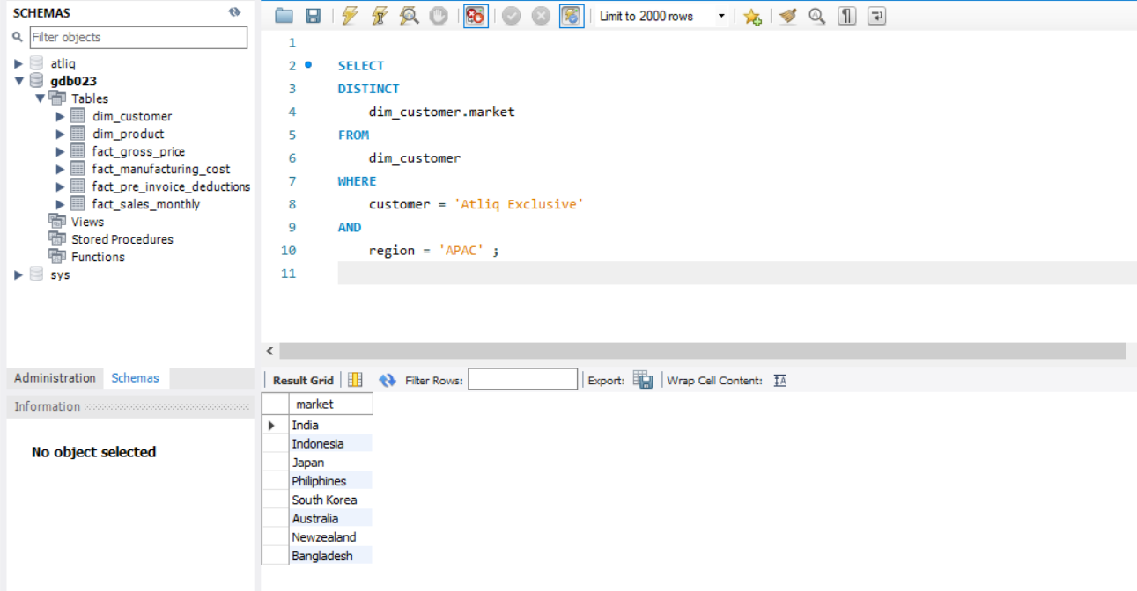
1. Provide the list of markets in which customer ‘Atliq exclusive’ operators its business in the apac region

Slide 4
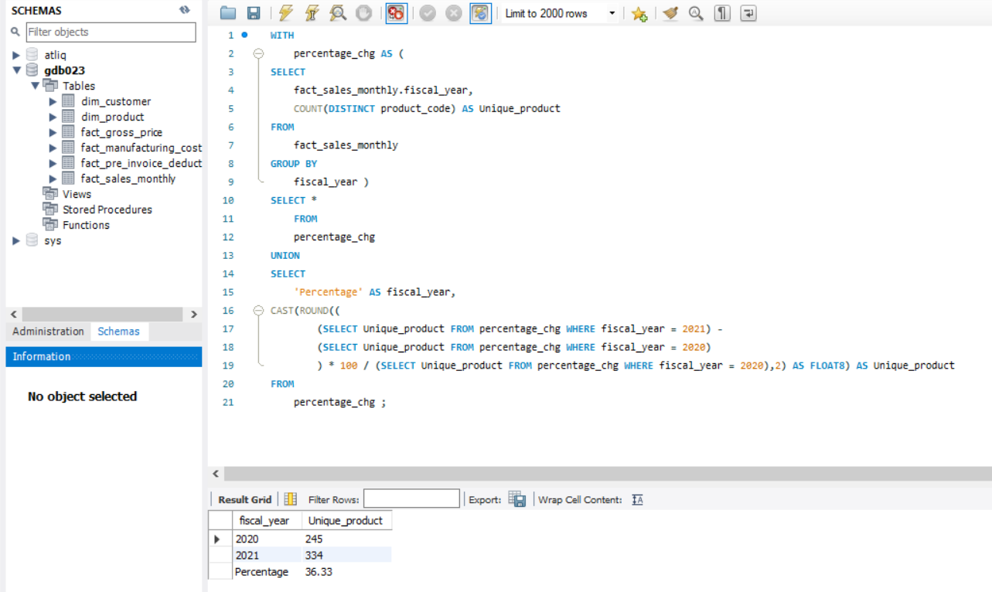
2. What is the percentage of unique product increase in 2021 vs 2020 ? The final outputs contains these product

Slide 5
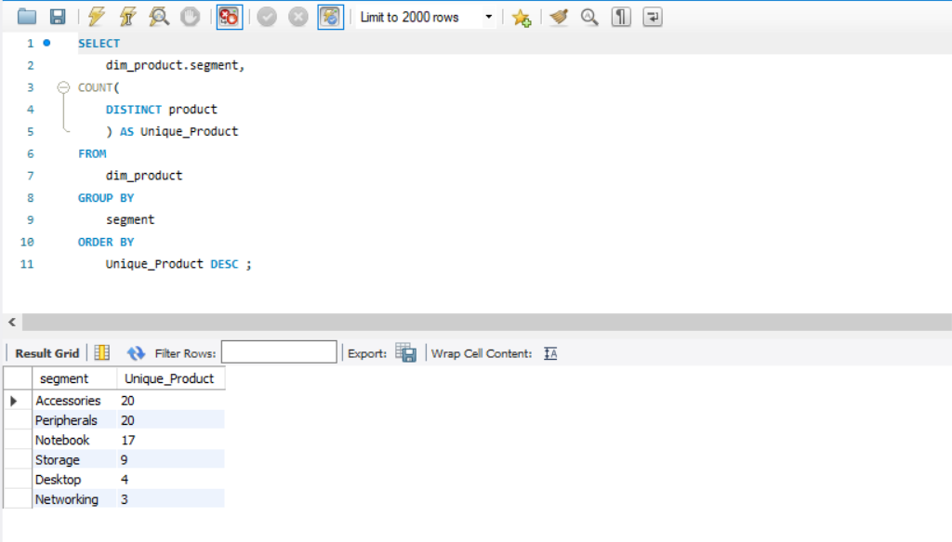
3. Provide a report with all the unique product counts for each segment and sort them in descending order of product counts. The final outputs contains 2 fields

Slide 6
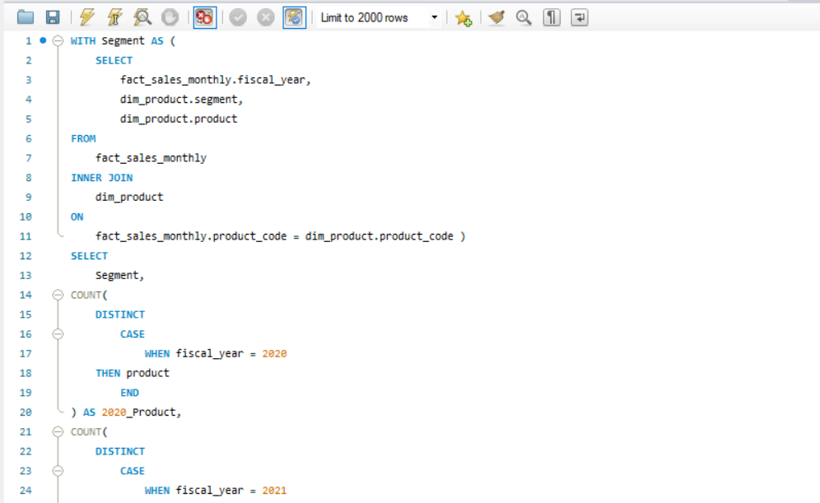
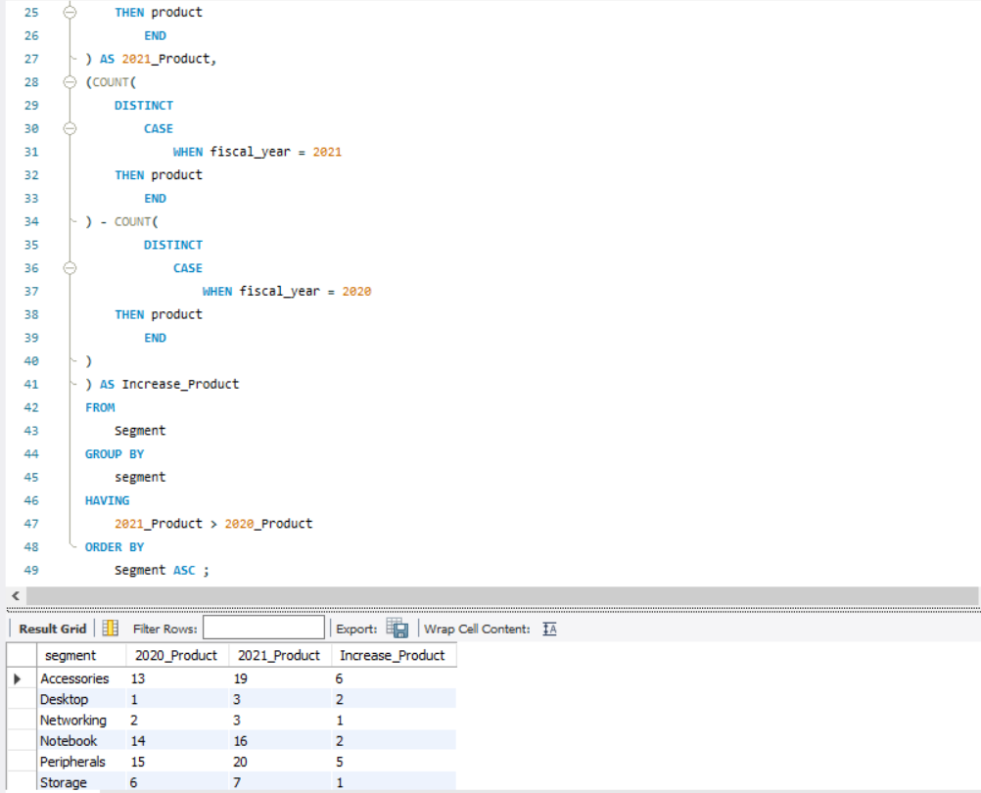
4. Follow up, which segments had the most increase in unique products in 2021 vs 2020? The final outputs contains these fields

Slide 7
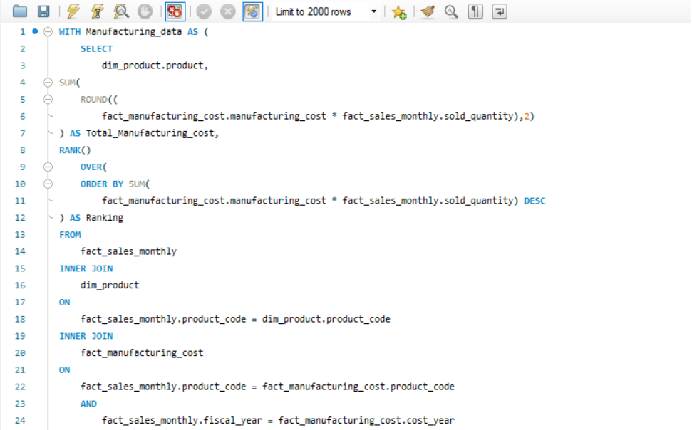
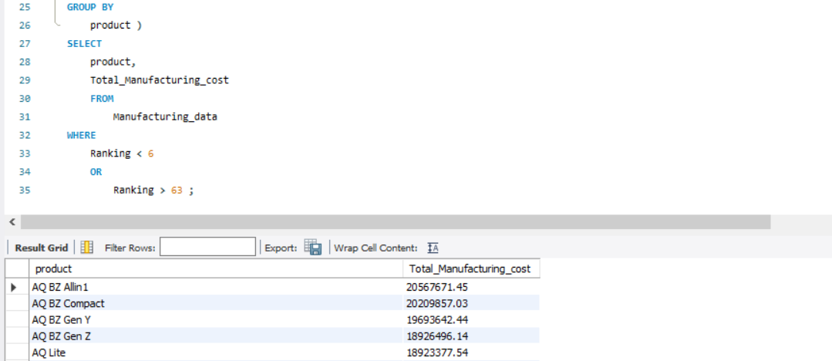
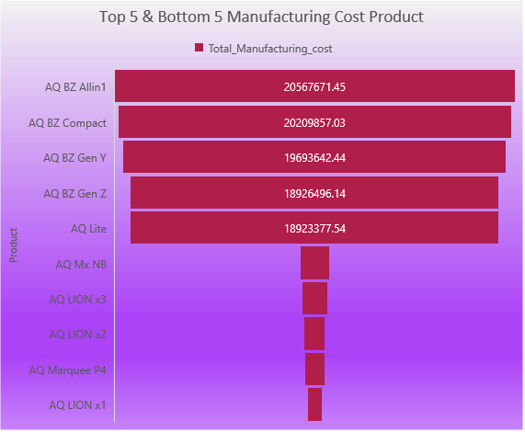
5. Get the product that have the highest and lowest manufacturing costs, the final output should contains these fields.

Slide 8
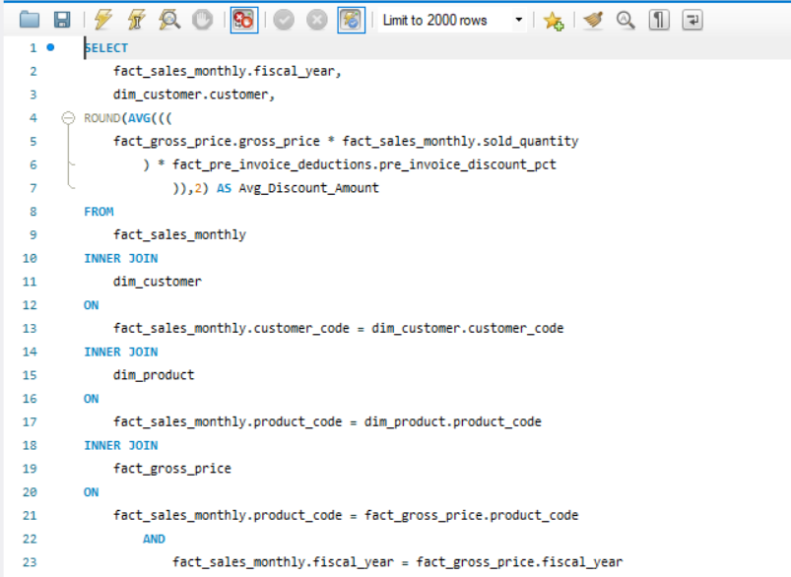
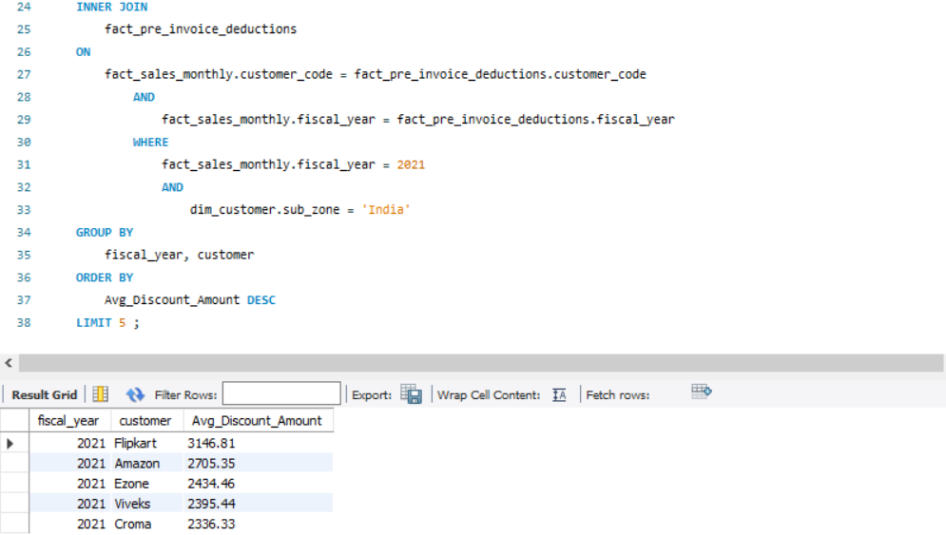
6. Generate a report which contains the top 5 customers who received an average high pre-invoice-discount-pct for the fiscal year of 2021 and in the Indian market. The final output contains these fields.

Slide 9
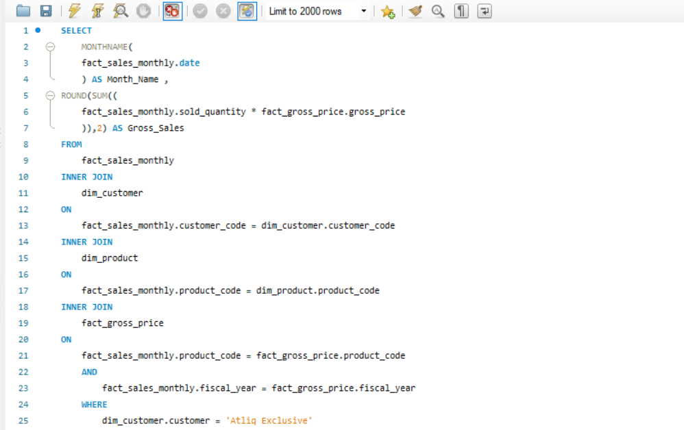
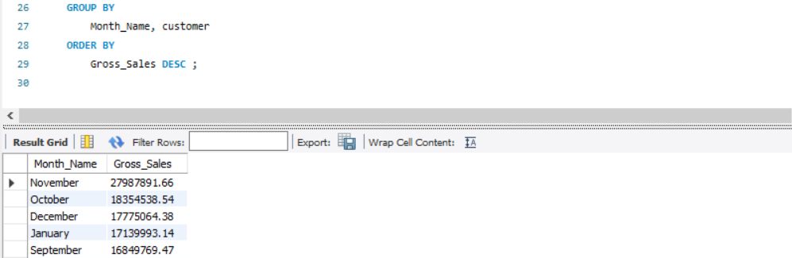
7. Get the complete report of the gross sales amount for the customer ‘’atliq-execlusive’’ for each month. This analysis helps to get an idea of low and high-performing month and takes strategic decisions.

Slide 10
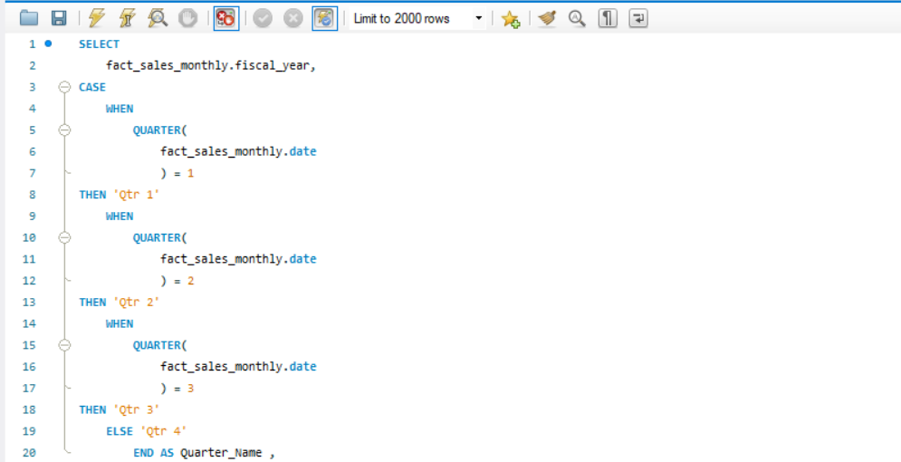
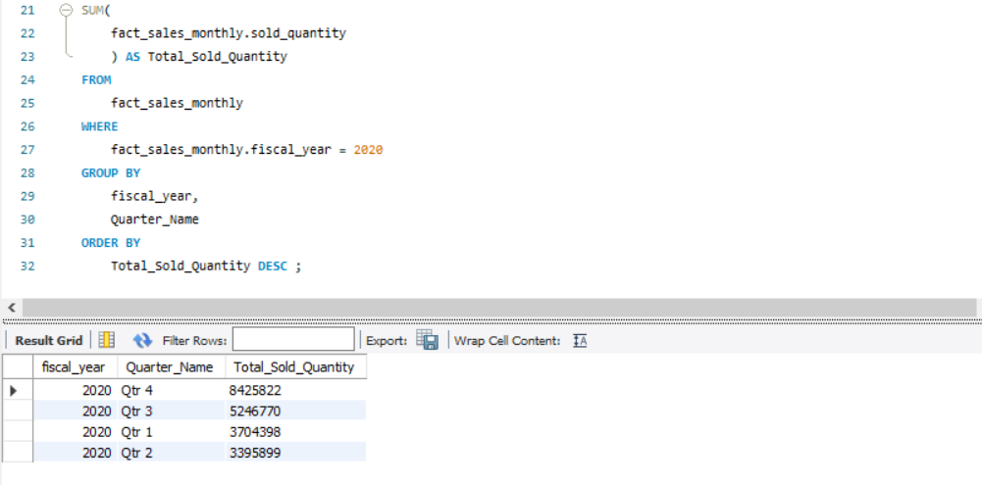
8. In which quarter of 2020, got the maximum total_sold_quantity ? The final outputs contains these fields sorted by the total_sold_quantity

Slide 11
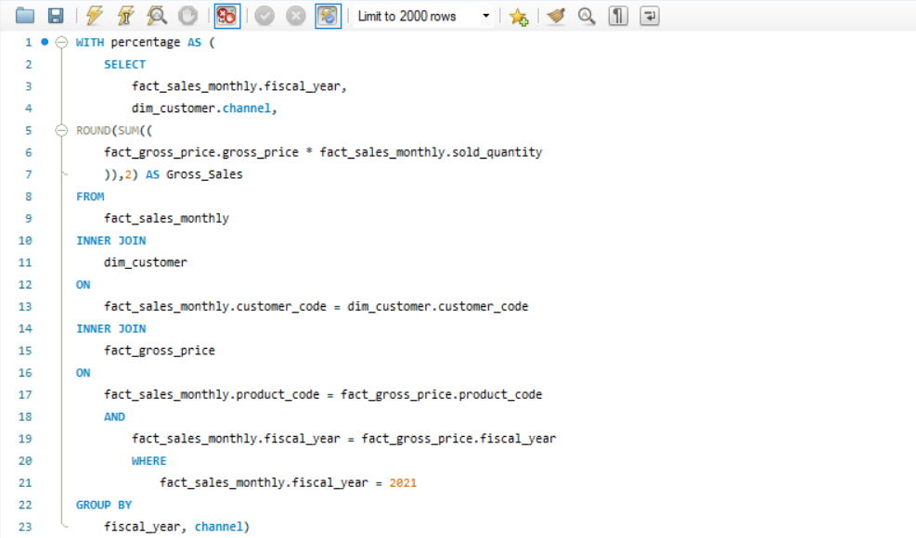
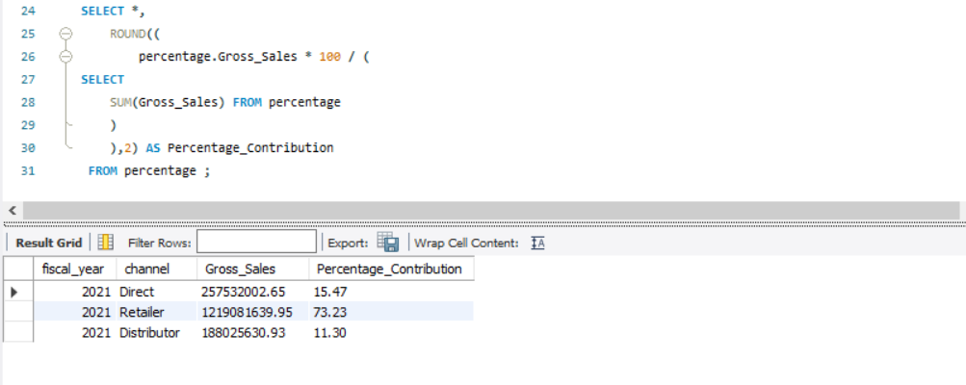
9. Which channel helps to bring more gross sales in the fiscal year 2021 and the percentage of contribution ? The final outputs contains these fields

Slide 12
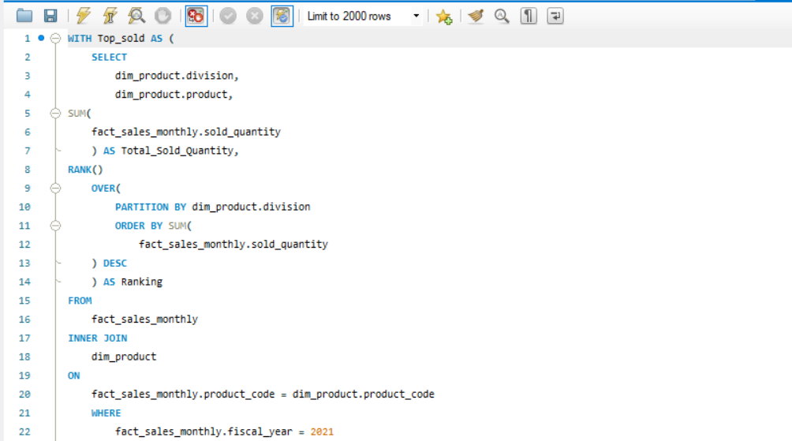
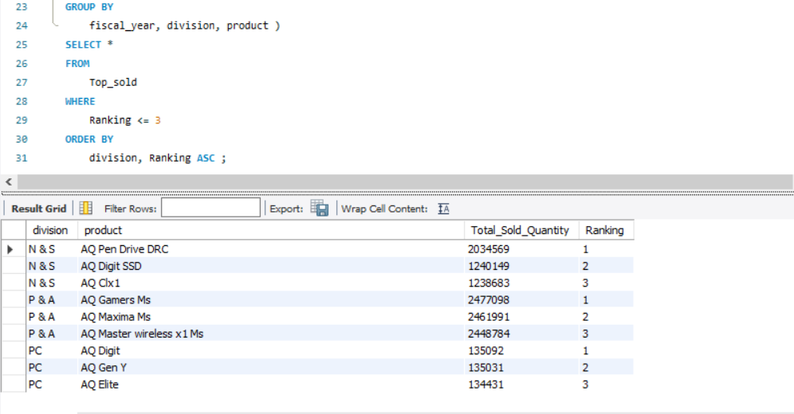
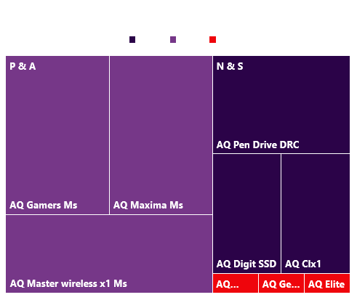
10. Get the top 3 product in each division that have a high total-sold-quantity in the fiscal year 2021 ? The final outputs contains these fields

Slide 13
Thank you

